Slide 1
Model View Controller

Slide 2
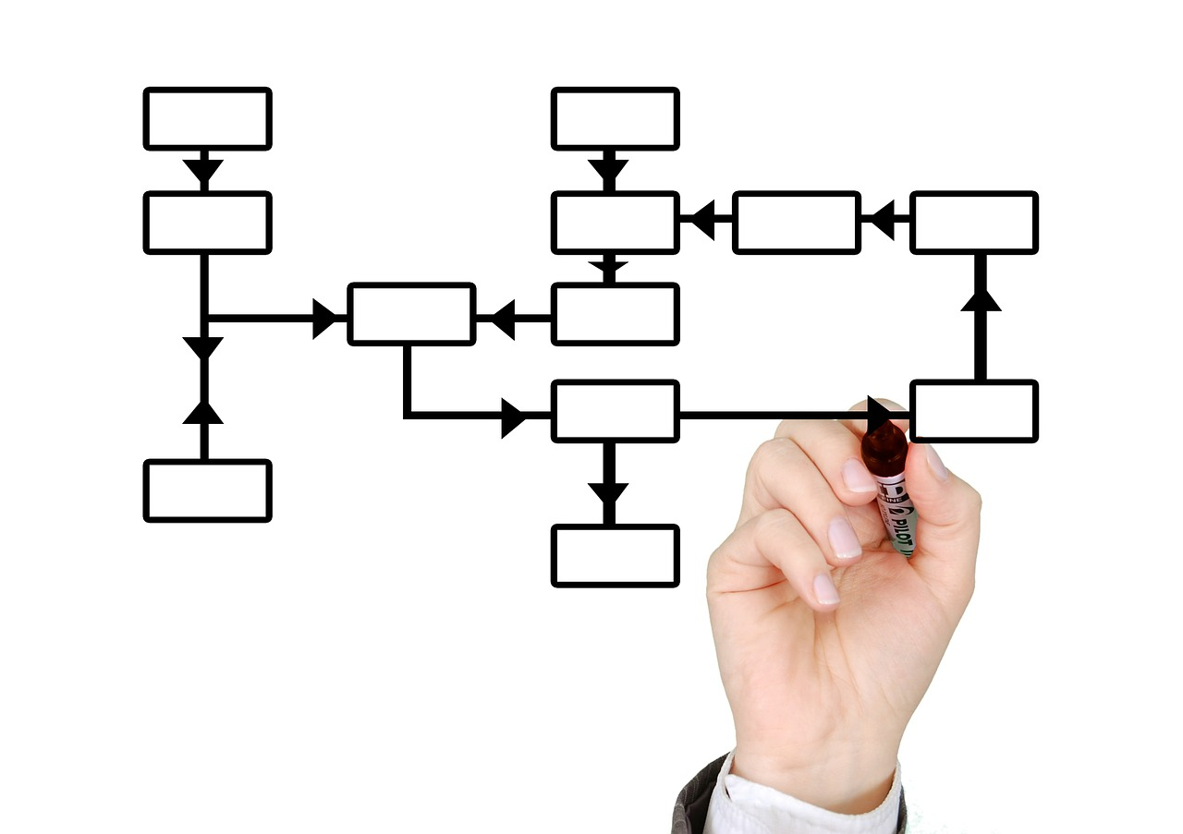
MVC Pattern
A software development pattern, principle or architecture that separates 3 primary system concerns
Model – objects representing application data
View – visual user interface that renders the model
Controller – performs logic, facilitates model and view interactions

Slide 3

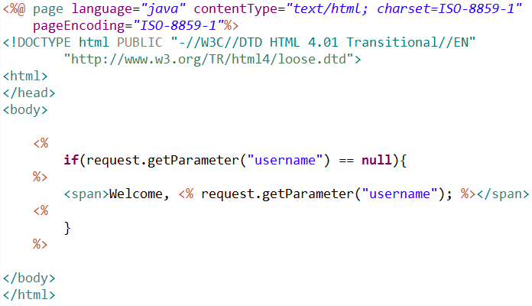
Motivation

Slide 4
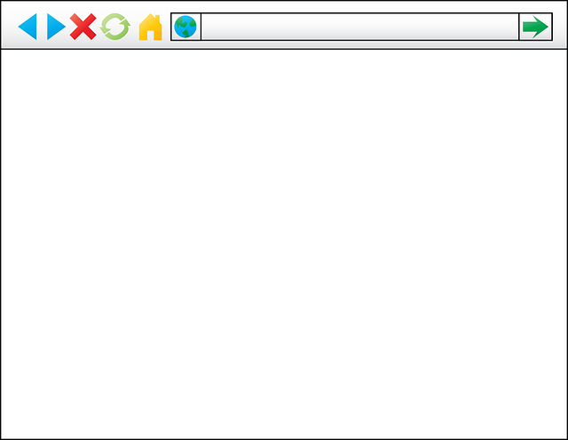
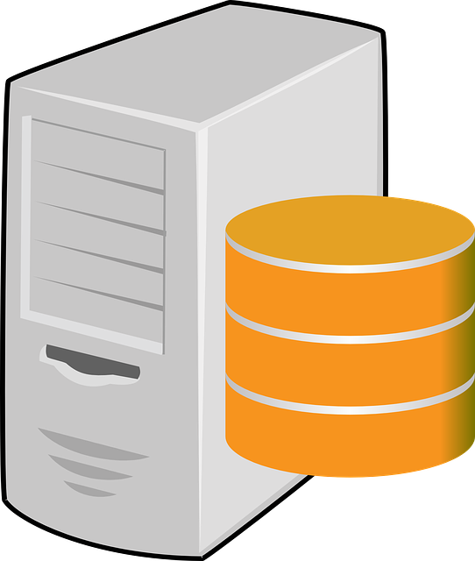
Application of MVC
Request
Java Web Application
Response
M
V
C
Server
Browser

Slide 5
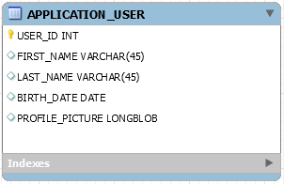
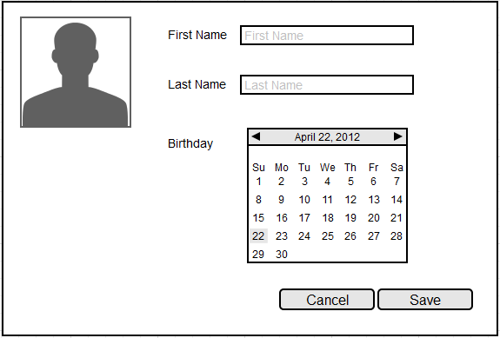

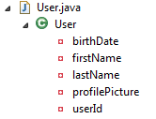
Application of MVC
Model
Controller
View

Slide 6
Benefits
Reduces coupling and dependencies increasing reuse and flexibility
Establishes an architecture for web applications
Separates application concerns improving code readability

